Slide 1
Tax Returns
and Transcripts
CCCSFAAA Financial Aid 101 Training
H-1
© 2017 Cheryl Hunt. All rights reserved.
Notes:
Prior to this session, you may have noticed that we had some pop-quiz questions running. I’ll reveal the answer to those questions throughout the presentation – so keep your best guesses handy.
With recent suspension of the Data Retrieval Tool and new guidance from ED stating signed copies of paper tax returns can now be used in lieu of transcripts we thought it might be good to get back to the basics.
For some of you, you’ve only ever worked with tax transcripts and/or DRT information – and for others, it’s maybe been a while – probably a VERY long while.
Hopefully you had the opportunity to print a copy of the tax transcript decoder that was sent to you when you registered for this event. – much of what we cover today will refer to that document.
We also made available a copy of this presentation for you to download and print. If you didn’t get a copy, let us know and we’ll email you a copy ASAP.
[----------------------
The numbers you see in the lower right-hand corner of the slide correspond to page numbers in your handout. Since you have two handouts for this session, the PPT slides and the Transcript Decoder, a number that starts with the letter ‘H’ relates to the page number of your PPT handout.

Slide 2
Agenda
New Guidance
2017-2018 Tax Transcript Decoder
Fifty-Cent Tour
Tax Transcript Basics
Types
Requesting
Registering for IRS Online Self-Help Tools
Resources
H-1
© 2017 Cheryl Hunt. All rights reserved.
Notes:
Here’s are agenda:
We’re going to make sure we’re all on the same page about the latest guidance the Department has issued about tax documentation as it relates to verification.
We’ll take a look at a job tool that should make your job much easier
Since transcripts are still in the picture, we’ll cover a few basics
…and I’ll mention a few resources that might be helpful to you and answer any questions you might have.
I want to make sure I set a realistic expectation as to what we’ll be able to cover today. Today’s session is how to use paper returns and tax transcripts for the purpose of verifying income-related data on the FAFSA.
Because we have a limited amount of time, here are some things we won’t be able to cover today…

Slide 3
This Session Will Not Cover…
How to complete verification
Tax filing requirements
Resolution of certain types of conflicting information:
399 codes, etc.
Special situations:
Nonresidents
Foreign tax returns
H-2
© 2017 Cheryl Hunt. All rights reserved.
Notes:
How to complete verification (beyond the scope of basic tax documents), or cover all of the verification requirements
Tax filing requirements (whether a person is required to file, what the correct filing status should be and whether or not someone can be claimed as an exemption)
We’ll touch on conflicting information as it relates to reviewing a 1040, but won’t get into specifics like how to resolve 399 codes
We also won’t be covering special situations like nonresidents or foreign tax returns.
We would LOVE to be able to cover everything, but we are limited by time.
I promise you won’t be disappointed. So are we good?

Slide 4
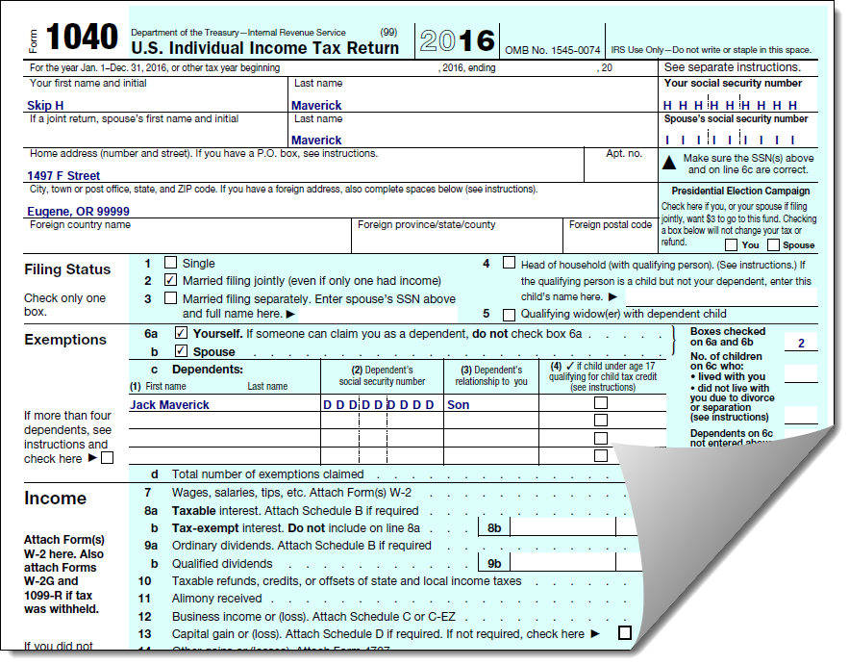
New Guidance: Effective April 24, 2017
2016-2017 and 2017-2018 Award Years (GEN-17-04)
May use signed paper copy of 2015 IRS tax return
H-2, 21
© 2017 Cheryl Hunt. All rights reserved.
Notes:
Jot down on your handout, GEN-17-04.
This is where you’ll find the new guidance provided by the Department on April 24 (you’ll find the URL on pg. 21 of your handout).
DRT Suspended – Changes to Verification Requirements Effective April 24, 2016kk
IRS Tax Return Filers
Schools may consider a signed paper copy of 2015 IRS tax return
Nontax Filers
Verification of Nonfiling – no longer required to collect letter from IRS

Slide 5
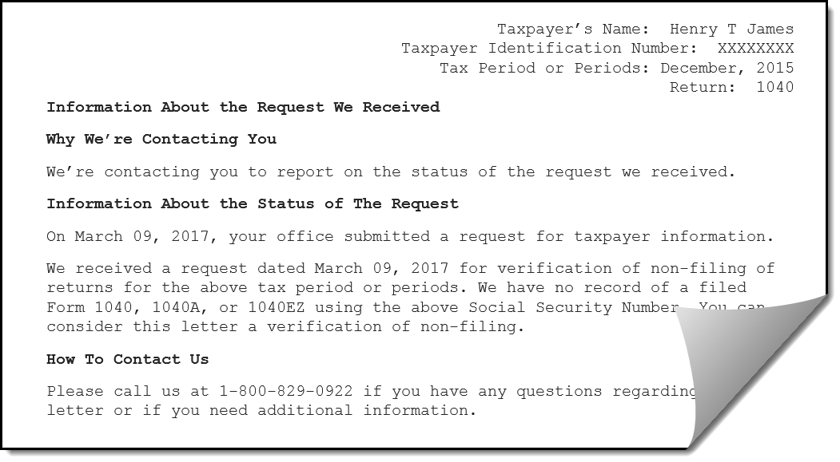
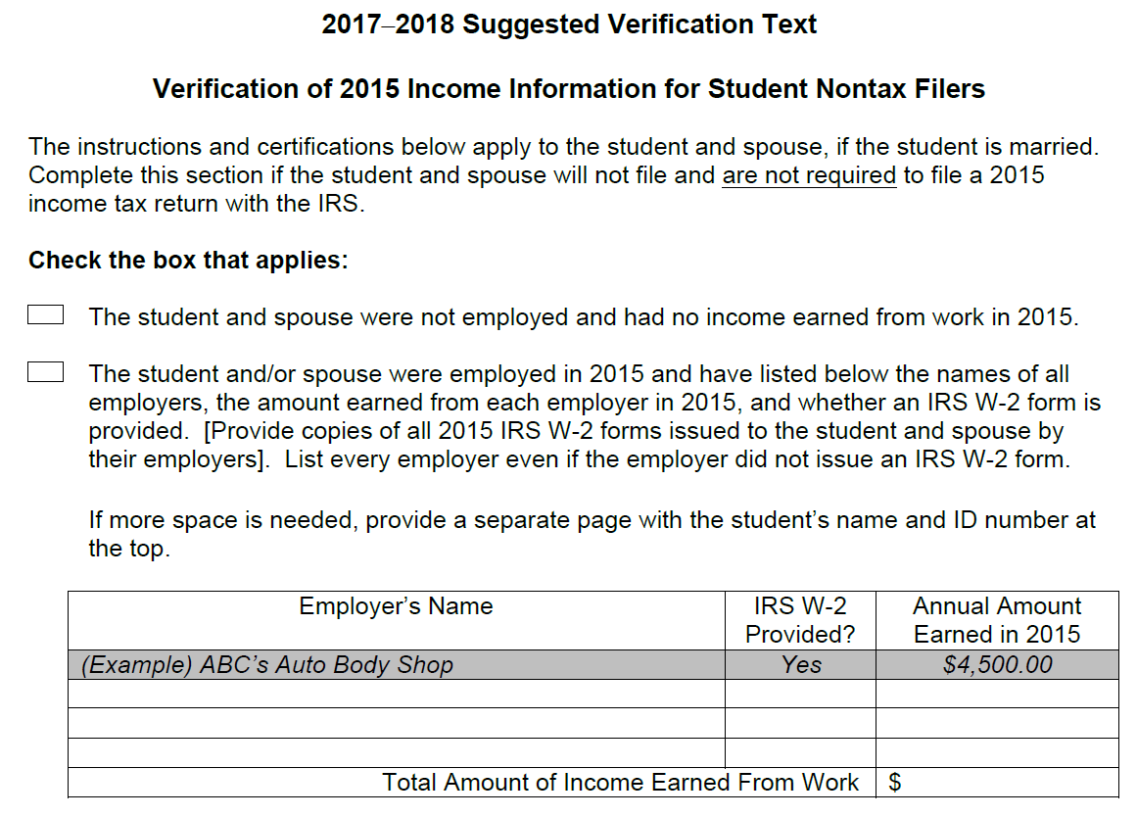
New Guidance: Effective April 24, 2017
2016-2017 and 2017-2018 Award Years (GEN-17-04)
Verification of Nonfiling letter no longer required
Collect signed statement.
H-3, 21
© 2017 Cheryl Hunt. All rights reserved.
Notes:
New Guidance
DRT Suspended – Changes to Verification Requirements Effective April 24, 2016
IRS Tax Return Filers
Schools may consider a signed paper copy of 2015 IRS tax return
Nontax Filers
Verification of Nonfiling – no longer required to collect letter from IRS

Slide 6
Agenda
New Guidance
2017-2018 Tax Transcript Decoder
Fifty-Cent Tour
Tax Transcript Basics
Types
Requesting
Registering for IRS Online Self-Help Tools
Resources
H-4
© 2017 Cheryl Hunt. All rights reserved.

Slide 7
2017-2018 Tax Transcript Decoder
The Fifty-Cent Tour
H-4 and TTD
© 2017 Cheryl Hunt. All rights reserved.
Notes:
[click on .50 graphic to go to pdf]
Use CTRL + [+] to enlarge image and use ‘hand’ to move around document.
--escape once to go to full view
--escape x 2 to go back to PPT
CTRL + ‘L’ = will cause PDF to go to full screen mode
Color coding
Tax RETURN line items
Tax return TRANSCRIPT line items
Paper return and corresponding tax transcript
GO BACK to PPT – to cover Appendix items

Slide 8
2017-2018 Tax Transcript Decoder
Page 3 – Color Key
Red
Cross-referenced tax return line items with corresponding data on tax transcript
Yellow
Required verification data
elements for 2017-2018
Blue
Items to review for potential
conflicting information
H-5 and TTD-3
© 2017 Cheryl Hunt. All rights reserved.

Slide 9
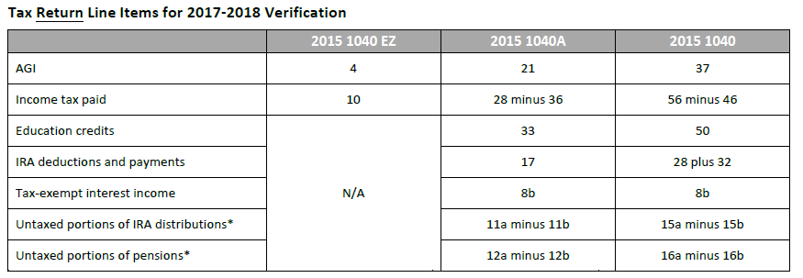
2017-2018 Tax Transcript Decoder
Page 3 – Tax Return Line Items
H-5 and TTD-3
© 2017 Cheryl Hunt. All rights reserved.
Notes:
NOTE to presenter: You can use your keyboard and type CNTL + (at the same time) and it will enlarge the slide. You can also then use your mouse to move the image to where you want to look.
When done, hit the ESC key just once – and you’ll be taken back to regular view.

Slide 10
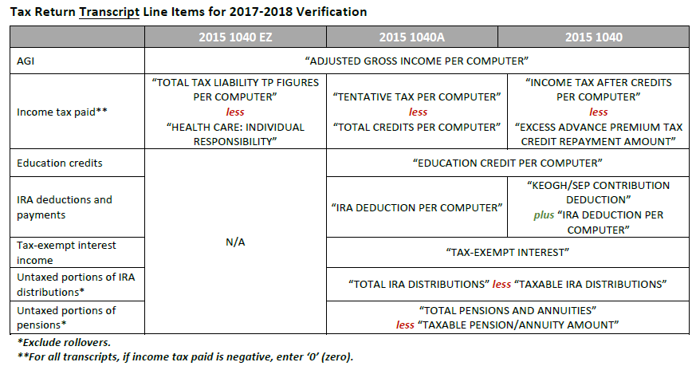
2017-2018 Tax Transcript Decoder
Page 3 – Tax Return Transcript Line Items
H-6 and TTD-3
© 2017 Cheryl Hunt. All rights reserved.
Notes:
NOTE to presenter: You can use your keyboard and type CNTL + (at the same time) and it will enlarge the slide. You can also then use your mouse to move the image to where you want to look.
When done, hit the ESC key just once – and you’ll be taken back to regular view.

Slide 11
Tax Transcript Decoder
Page 23 – Appendices
Appendix A: Sample W-2 and Box 12 Codes
Appendix A: Sample W-2 Wage and Tax Statement
Appendix B: Criteria for SNT and Auto Zero EFC
Appendix C: Eligible to File a 1040A/EZ?
Appendix D: Current Year Transcript Availability
Appendix E: IRS Online Self-Help Tools Registration
H-6 and TTD-23
© 2017 Cheryl Hunt. All rights reserved.

Slide 12
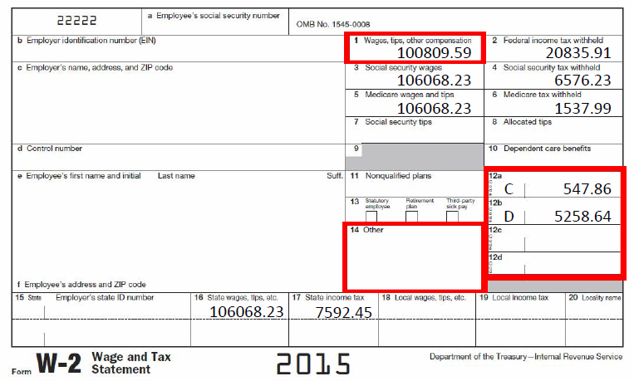
Appendix A: Sample W-2
H-7 and TTD-24
© 2017 Cheryl Hunt. All rights reserved.
Notes:
NEW for 2017-2018: Individuals who submit W-2s that total a gross income that equals or exceeds the IRS filing threshold must request a SSN, ITIN or EIN and file an income tax return before the student is eligible to receive Title IV aid. [Guidance issued 10/6/2016; and applies beginning with the 2017-2018 award year] http://www2.ed.gov/policy/highered/reg/hearulemaking/2009/verification.html

Slide 13
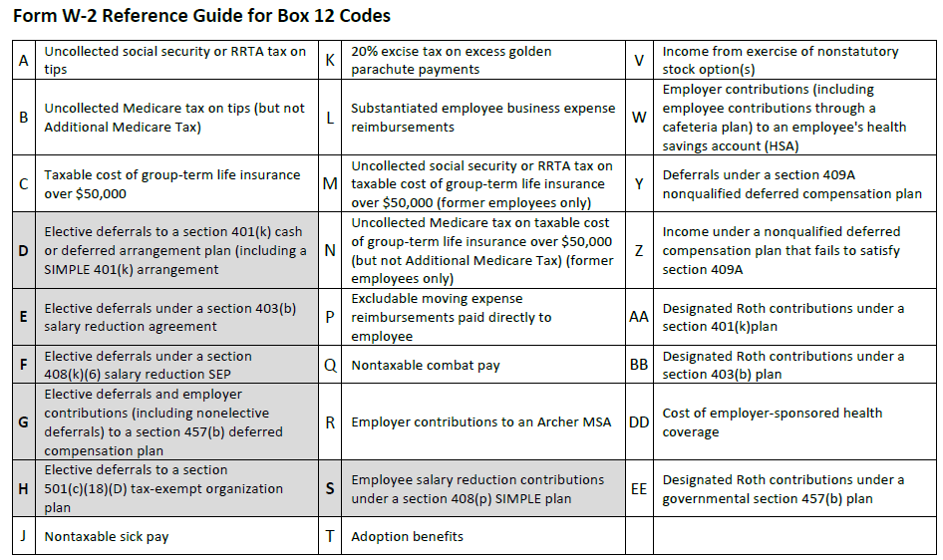
Appendix A: W-2 Box 12 Codes
H-7 and TTD-24
© 2017 Cheryl Hunt. All rights reserved.

Slide 14
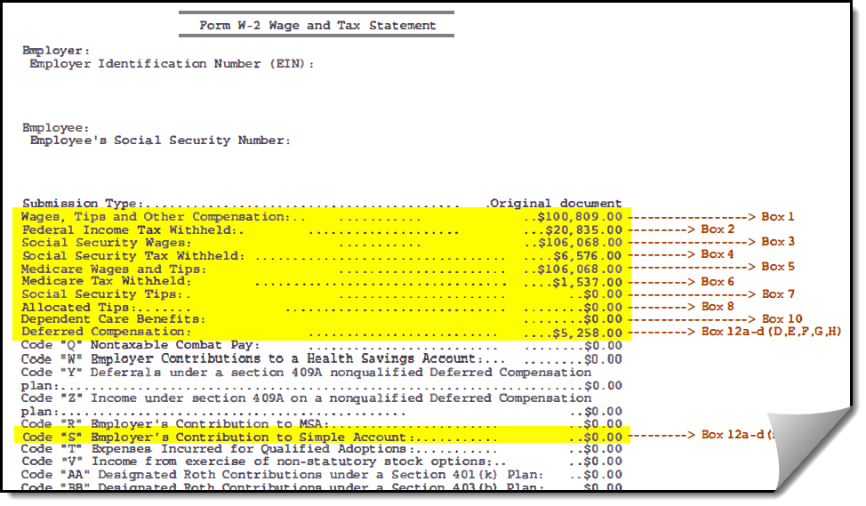
Appendix A: Sample Wage and Tax Statement
Corresponds with
Sample W-2 on pg. 24
H-8 and TTD-24, 25
© 2017 Cheryl Hunt. All rights reserved.

Slide 15
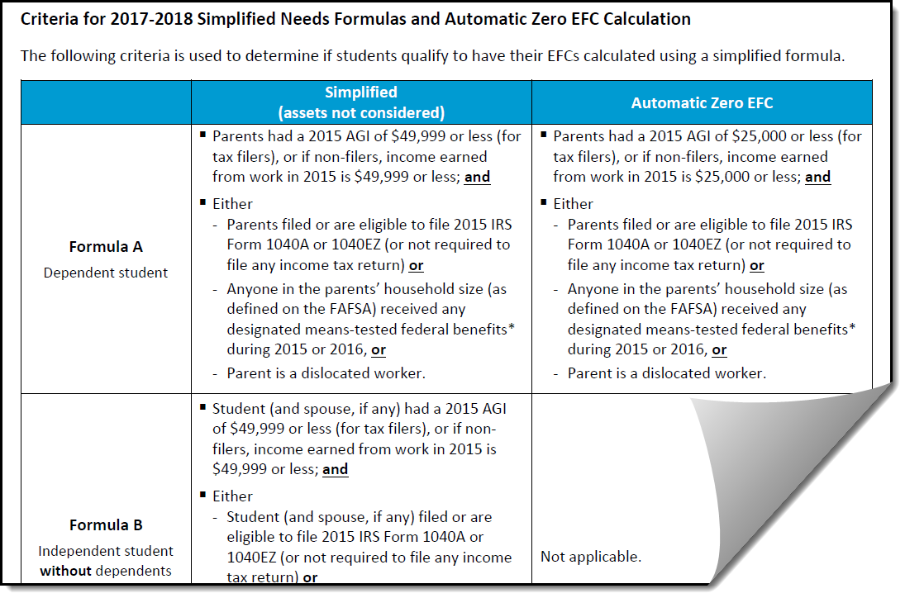
Appendix B: Criteria for SNT and Auto Zero EFC
H-8 and TTD-27
© 2017 Cheryl Hunt. All rights reserved.
Notes:
We took a look at this chart during the EFC session, I wanted to include it here as well as a reminder that one of three criteria that need to be met (in addition to an income threshold) has to do with whether or not a 1040 filer could have filed a 1040A or 1040EZ.

Slide 16
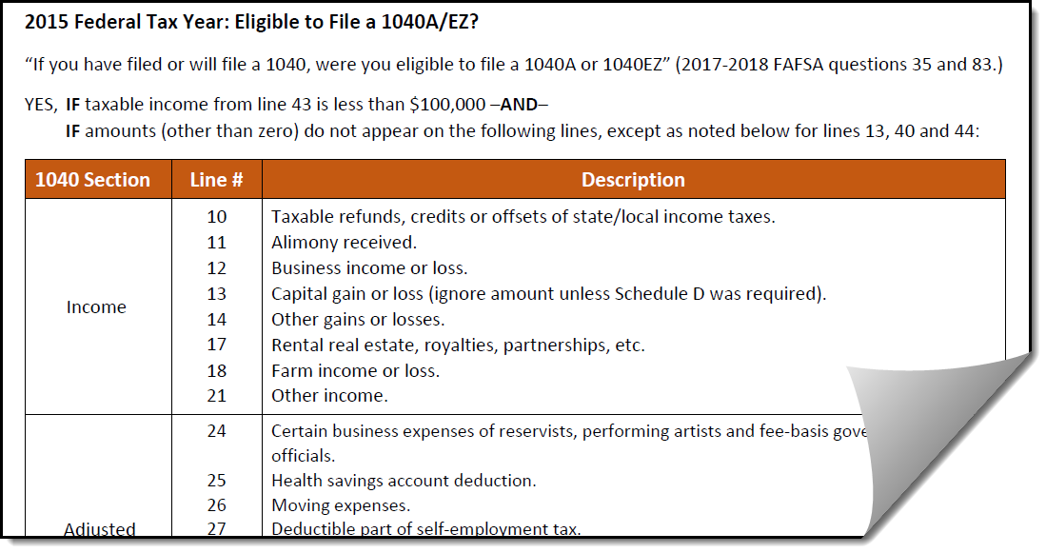
Appendix C: Eligible to File a 1040A/EZ?
H-9 and TTD-28
© 2017 Cheryl Hunt. All rights reserved.
Notes:
Appendix C is a tool that can be used to determine if a tax filer answered that funky FAFSA question “if you filed or will file a 1040, were you eligible to file a 1040A or 1040EZ?”
We’ll take a look at this a little more closely when we dig into our case study.

Slide 17
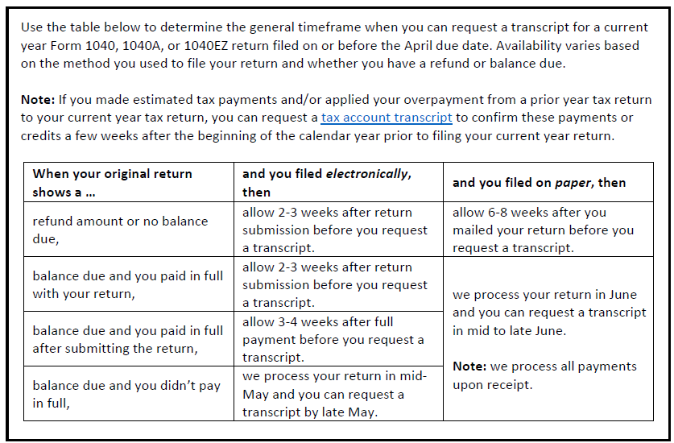
Appendix D: Current Year Transcript Availability
H-9 and TTD-35
© 2017 Cheryl Hunt. All rights reserved.

Slide 18
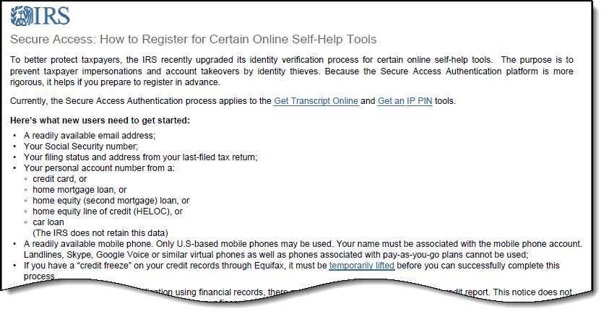
Appendix E: IRS Online Self-Help Tools Registration
H-10 and TTD-36
© 2017 Cheryl Hunt. All rights reserved.
Notes:
There’s super helpful information on the IRS website as to how to register for use of the IRS Online Self-Help Tools – like GET TRANSCRIPT ONLINE.
The information you have on pg. 36 was updated this year, so you’ll want to use the URL on pg. 21 to get the most updated version.

Slide 19
STUDY TIME
H-18
© 2017 Cheryl Hunt. All rights reserved.
Notes:
It’s case study time!
Using some of the tools in the Tax Transcript Decoder, let’s review a paper 1040.
[next slide]

Slide 20
Case Study – Caroline
V1 Standard Verification Group – 1040
Verify her income information using the following documents:
ISIR data sheet
1040 paper tax return
Tax Transcript Decoder
H-18, 19, 20 and TTD
© 2017 Cheryl Hunt. All rights reserved.
Notes:
--3 clicks--
Okay, let’s put our knowledge to the test with a case study.
Caroline is an independent student who filed a form 1040
She was selected for verification – and is in the V1 Standard Verification Group
To verify her information you have: [CLICK 1]
A worksheet with certain ISIR data…
A copy of her paper return [CLICK 1]
…and [CLICK 3] (should you choose) you can use the Tax Transcript Decoder
[next slide]

Slide 21
Case Study – Caroline
V1 Standard Verification Group – 1040
H-18
© 2017 Cheryl Hunt. All rights reserved.
Notes:
With the V1 group you’re required to verify household size and number in college – since we’re focusing today on the income-related information, we’ve verified these two items for you based on verification information we received Caroline.
Is there any documentation you have that might cause you to disagree with 3 in family and 1 in college? If so, why?
[if it comes up, discuss that there are different definitions for who can be claimed as a dependent on an IRS 1040 and who can be considered in the household size on the FAFSA.
Ask if anyone can tell you why these numbers might be different.
Examples:
FAFSA asks for prior-prior year information (in this case 2015), whereby the household size is based on the academic year (in this case, July 1, 2017 through June 30, 2018)
_________________
Ok, let’s move on to the next section.

Slide 22
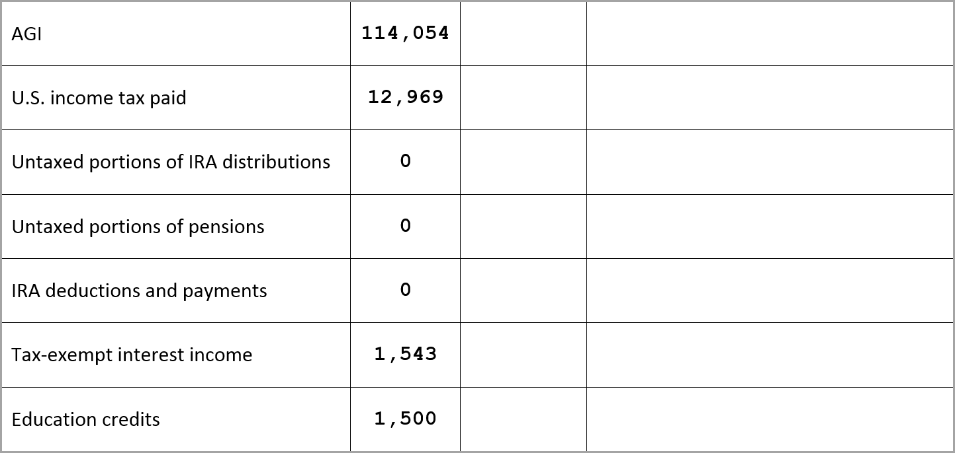
Case Study – Caroline
V1 Standard Verification Group – 1040

114,054
11,258
Correct ISIR

0

0

0
0
Correct ISIR

1,500
H-18, 19, 20 and TTD
© 2017 Cheryl Hunt. All rights reserved.
Notes:
--10 clicks--
[CLICK 1] These are the seven required income-related items for the V1 group.
[CLICK 2]
The second column contains Caroline’s information as reported on her FAFSA.
[CLICK 3]
Take a few minutes and enter the correct answers in the Document Data column.
When I see the majority of you are done… we’ll go through the answers together.
What was your finding for AGI? [CLICK 4] [correct!]
How about income tax paid? [CLICK 5]
This can be a common error if the family is entering their tax information in manually – where does it look like Caroline got her figure from? [tax withheld] – will we need to correct the ISIR?
[CLICK 6] Yes! For students who are selected for verification and receiving subsidized
student aid, changes that result to any non-dollar item and to any dollar item
of $25 or more must be submitted for processing.
[I did an EFC calc for Caroline (age 30) with $10k in assets, and daughter in college at least half time – EFC was 9,605, so it is possible she might be eligible minimally for a subsidized loan. – for additional information on corrections, refer to the Application and Verification Guide]
Was there anything off for these next three items? [no, so we’re good] [CLICK 7]
How about tax exempt income? [CLICK 8]
We’re off, right? Looks like she picked up qualified dividends instead.
Need to correct the ISIR? [YES] [CLICK 9]
How about education credits? [CLICK 10] [no, so we’re good]
[---------------------------
Before we move forward, share with me what you used to determine your answers (the chart on pg. 3 of the decoder, or pages 14 and 15, or maybe you’re a pro and you just know where to look? Did it help to have something to use as a guide?
[---------------------------
Okay…so these are the ‘required’ items for verification, but there are still some items on the 1040 that potentially could be conflicting information.

Slide 23
Case Study – Caroline
V1 Standard Verification Group – 1040

1040
H-18, 19, 20 and TTD
© 2017 Cheryl Hunt. All rights reserved.
Notes:
--3 clicks--
[CLICK 1] Did Caroline file a 1040? [CLICK 2] Yep! So we’re good there.
[CLICK 3] Okay…so how about that funky question on the FAFSA that asks “if you have filed or will file a 1040, were you eligible to file a 1040A or EZ?” Caroline indicated she didn’t know the answer to that question.
Can someone tell me why that might be important? [yes, if someone’s income was within the income range of either simplified needs (assets excluded) or automatic zero EFC – this would meet one of three other criteria, if the answer is yes]

Slide 24
Appendix B: Criteria for SNT or Auto-Zero EFC
TTD-27
© 2017 Cheryl Hunt. All rights reserved.
Notes:
NOTE to presenter: You can use your keyboard and type CNTL + (at the same time) and it will enlarge the slide. You can also then use your mouse to move the image to where you want to look.
When done, hit the ESC key just once – and you’ll be taken back to regular view.
Let’s take a quick peek at Appendix B (pg. 27 of the tax transcript decoder).
[ click 1 ] Caroline is an independent with dependents other than a spouse, so we’d look at Formula C.
Now… right off the bat she doesn’t qualify for either SNT or Auto-Zero EFC because her AGI is greater than 49,000…but if she did meet the income criteria (let’s say her AGI was $45,000) and had answered that funky question about being eligible to file a 1040EZ or A ‘no’ or ‘don’t know’ she would have missed out on having her assets excluded from the EFC calculation – that’s why it’s important to confirm the answer to this question.
You also might find that the reverse is true…that an applicant who answered YES to this question but shouldn’t have… could potentially have an incorrect EFC which might cause them to be eligible for need-based aid that they otherwise wouldn’t have qualified for.
Does that make sense?

Slide 25
Case Study – Caroline
V1 Standard Verification Group – 1040

1040
H-18, 19, 20
© 2017 Cheryl Hunt. All rights reserved.
Notes:
So what can we use us to help determine the correct answer to this question?
Appendix C, starting on page 28 of the Tax Transcript Decoder

Slide 26
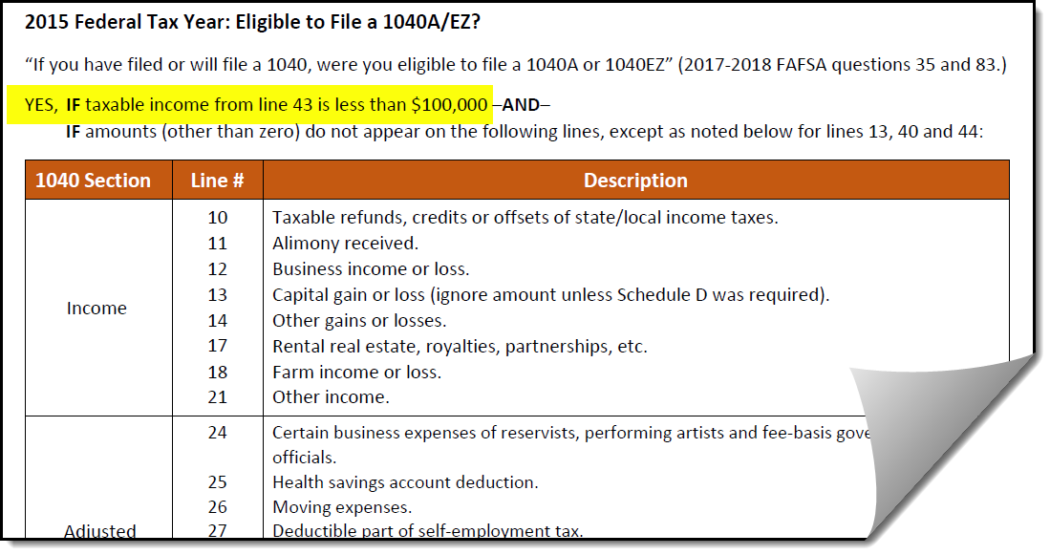
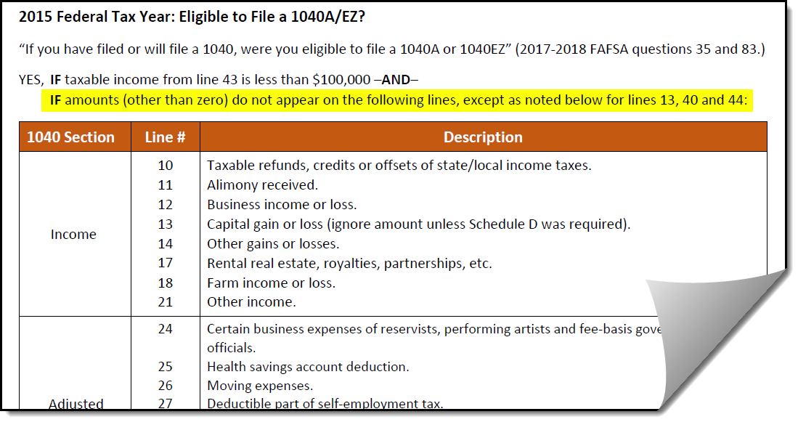
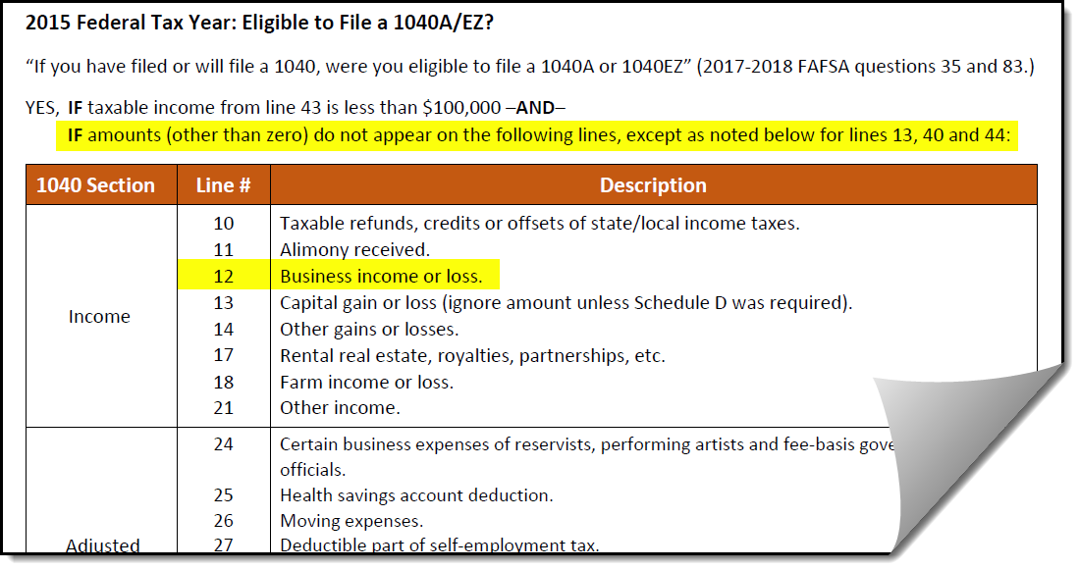
No
Appendix C: Eligible to File a 1040A/EZ?
H-18, 19, 20 and TTD-28
© 2017 Cheryl Hunt. All rights reserved.
Notes:
--4 clicks--
The most efficient way to start is with the income criteria. [click 1]
Is the amount on line 43 less than $100,000? [No…so we move to the next item] [click 2]
Starting with line 10 on the 1040 and working our way down, is there an amount (other than zero) on any of the lines in the first section? Yes…[click 3] business income.
We don’t have to look any further. The answer to whether or not Caroline was ‘eligible to file a 1040A or EZ is [click 4] NO…because of the business income.
Oh, and if you’d prefer a color-coded visual aid, you’ll see starting on pg. 29 I’ve given you just that. And following that on page 31 you’ll find the corresponding color-coded tax return transcript.

Slide 27
Case Study – Caroline
V1 Standard Verification Group – 1040

1040
No
Correct ISIR
?
Collect W-2s, Schedule C and/or written statement
Correct ISIR
?
H-18, 19
© 2017 Cheryl Hunt. All rights reserved.
Notes:
--5 clicks--
[click 1] So we would correct the answer from ‘don’t know’ to ‘no’ – even though (in this case) changing the answer won’t affect the EFC (because her AGI is above the limit), it would be a good practice to make the change while we are making our other corrections for Caroline.
Also, just so you know, an answer of “don’t know” to this question equals “no” when the EFC calculation is done.
[click 2] Ok…so why are we looking at ‘wages earned’ for someone who is selected for V1 and is a tax filer? Because we have information on the 1040 that potentially could be conflicting information.
The FAFSA instructions say that wages earned for a 1040 filer can be found on lines 7 + 12 + 18.
What do lines 7 + 12 + 18 add up to for Caroline? [112,472]
What was reported on the FAFSA totals [113,964]
By looking at the paper return, can you clearly discern how much of that total is attributed to Caroline and what belongs to her spouse? [click 3]
No, not really. [click 4]
The spouse’s wages of 102,294 match line 7, but Caroline’s wages reported on her FAFSA do not match what’s on the 1040.
So you’d have to collect W-2s, maybe a schedule C and/or a written/signed statement indicating the correct amounts. In this case, more likely than not the business income on line 7 belongs solely to Caroline, but we can’t say that with all certainty.
Here’s where having a tax transcript can actually help. When you get a tax transcript you get all of the schedules as well as pg. 1 and pg. 2 information.
In Caroline’s case, there’s business income on line 12 – a schedule C or C-EZ would tell us if the income belongs to her or to her husband and might help to clear up the conflict.

Slide 28
Case Study – Caroline
V1 Standard Verification Group – 1040
TTD-16, 19, 20
© 2017 Cheryl Hunt. All rights reserved.
Notes:
--2 clicks--
As an example, take a look at pg. 16 of the tax transcript decoder.
You’ll see there’s an amount for business income of $5,757
[click 1]
Now take a look at pg. 19…do you see the third section titled ‘Schedule C—Profit or Loss From Business?
There’s an SSN that will help to match the business income with the correct tax filer.
[click 2]
With this example you can see that the figures match and we would know who to attribute the income to.

Slide 29
Case Study – Caroline
V1 Standard Verification Group – 1040
Verify her income information using the following documents:
ISIR data sheet
1040 paper tax return
Tax Transcript Decoder
© 2017 Cheryl Hunt. All rights reserved.
Notes:
Just a few more things you might want to note in the blank area on pg. 18. In reviewing a paper return (or even a tax transcript), you’ll also want to consider things like:
Is the paper return signed?
Do you have the correct tax year? This can get tricky with the implementation of prior, prior year income.
Families are used to providing you with current tax year information, so don’t be surprised if you get some 2016 paper returns or transcripts instead of 2015. ALWAYS check that you have the correct year BEFORE you start/complete verification.
Equally critical…make sure you have the correct tax filers information – this could get tricky with divorced/separated, remarried and/or married filers who file jointly.
Match the # of exemptions with the corresponding FAFSA question (student and/or parent) – correct if necessary.
What if the assets are listed as zero on the ISIR, but there is interest or dividend income reported on the 1040 – this might or might not indicate conflicting information. It’s a little trickier now, than it was, because the FAFSA asks for assets as of the day the form is completed – which could have been Oct. 1, 2016. And you’re looking and interest and dividend income reported for tax year 2015.
Was this case study helpful?
My hope is that even some of you verification pros picked up a thing or two – maybe you were already checking these things, but chances are that not EVERYONE on your staff is.
[next slide]

Slide 30
Agenda
New Guidance
2017-2018 Tax Transcript Decoder
Fifty-Cent Tour
Tax Transcript Basics
Types
Requesting
Registering for IRS Online Self-Help Tools
Resources
H-10
© 2017 Cheryl Hunt. All rights reserved.
Notes:
NOTE to presenter: If you’re running short on time, let them know that the tax transcript basics are pretty straight-forward and that helpful information can be found on pg. H-21, under the IRS Revenue Service header.
xxx

Slide 31
Tax Transcript Basics
Most Common Types
Return Transcript
Account Transcript
Record of Account
Verification of Nonfiling
Form W-2 Wage and Tax Statement
Form 1099, 1098 or 5498 Series
H-11
© 2017 Cheryl Hunt. All rights reserved.
Notes:
--11 clicks--
NOTE to presenter: If you’re running short on time, let them know that the tax transcript basics are pretty straight-forward and that helpful information can be found on pg. H-21, under the IRS Revenue Service header.
These are the most common types of transcripts you can obtain from the IRS
Of the first three, which can be used for verification?
The account transcript can’t be used because it doesn’t contain all of the necessary information.
The Record of Account can be used because it includes the entire detail from the return transcript + other information

Slide 32
Tax Transcript Basics
Requesting
Request Method | Where? | Tax Transcript Output Document
 |  | What? | How? | When? | Direct to Third Party?
Get Transcript ONLINE | www.irs.gov/transcript | PDF | Electronic | Immediate | No
Get Transcript by Mail | www.irs.gov/transcript | Paper | Mailed | 5-10 days | No
Telephone | (800) 908-9946 | Paper | Mailed | 5-10 days | No
IRS Form 4506T-EZ | https://www.irs.gov/pub/irs-pdf/f4506tez.pdf | Paper | Mailed | 5-10 days | Yes
IRS Form 4506T | https://www.irs.gov/pub/irs-pdf/f4506t.pdf | Paper | Mailed | 5-10 days | Yes
H-11
© 2017 Cheryl Hunt. All rights reserved.
Notes:
AVG-82 (Verification) – see two sidebars
Form 4506T-EZ: Short Form Request for Individual Tax Return Transcript
Can mail or fax
Tax Return Transcript ONLY
Use 4506T to request a transcript or other return information

Slide 33
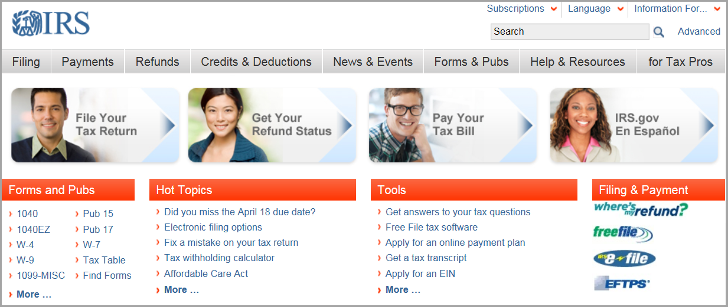
Tax Transcript Basics
Requesting
H-12
© 2017 Cheryl Hunt. All rights reserved.

Slide 34
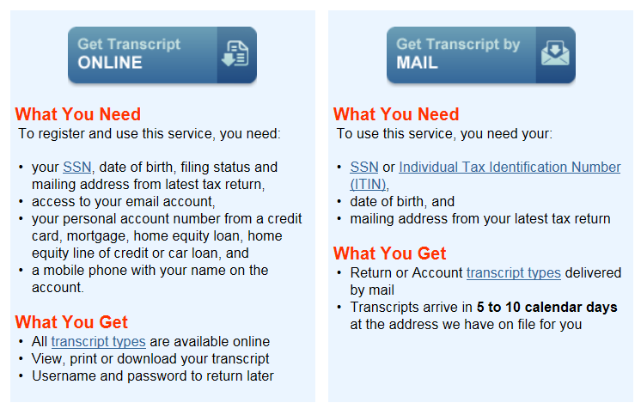
Tax Transcript Basics
Get Transcript ONLINE and Get Transcript by MAIL
H-12
© 2017 Cheryl Hunt. All rights reserved.

Slide 35
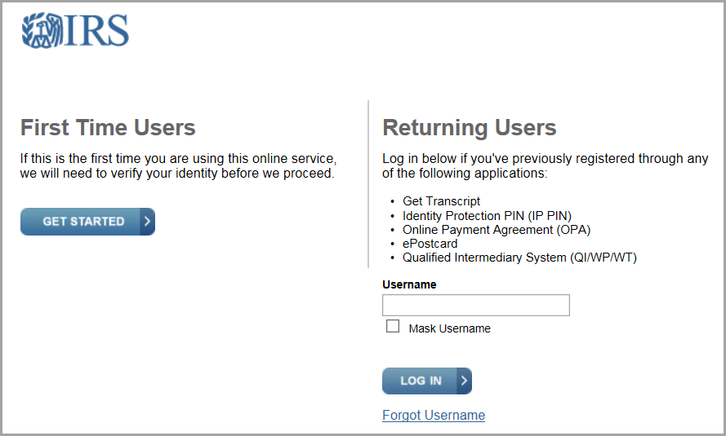
Tax Transcript Basics
Registering for IRS Online Self-Help Tools
H-13
© 2017 Cheryl Hunt. All rights reserved.

Slide 36
Tax Transcript Basics
Registering for IRS Online Self-Help Tools (First-time Users)
First and last name | SSN or ITN | Mobile phone (associated with name) Enter 6-digit activation code sent to mobile phone
Email address (readily accessible) Enter confirmation code sent to email | Filing status and address from last-filed return | Create: username and password Choose: site phrase and image
DOB
Personal account number from one of following:
credit card (last 8 digits)
home mortgage/equity loan
home equity line of credit
car loan
H-13
© 2017 Cheryl Hunt. All rights reserved.
Notes:
Earlier I mentioned Appendix E in the Tax Transcript Decoder document – There you will find a list of what new users, first-time users and returning users need in order to access their tax information online.
1. Name
2. Email address > confirmation code sent to email
3. DOB
4. SSN or ITIN
5. Filing status and address from last-filed return
6. Personal Account Information
Mobile phone
6-digit activation code (can receive by text, receive by postal mail (5-10 calendar days or other options not requiring a phone)
Username
Password
Choose a Site Phrase
Choose a Site Image

Slide 37
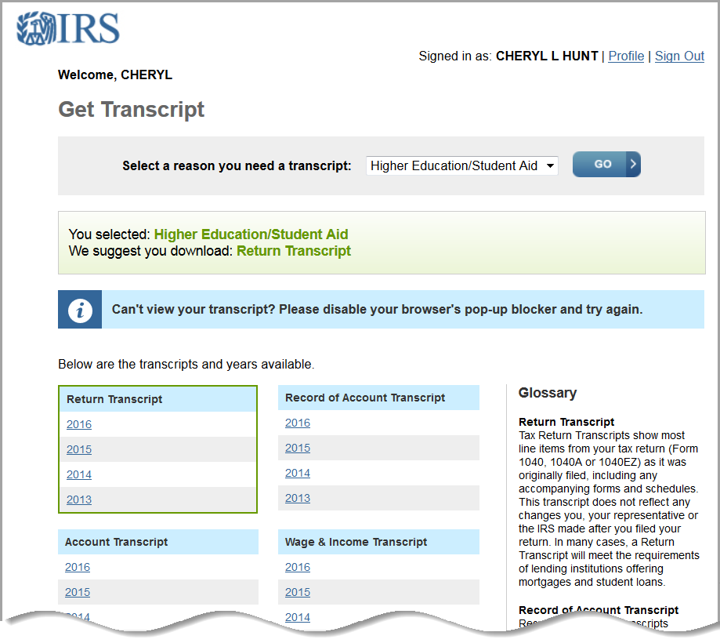
Tax Transcript Basics
Get Transcript ONLINE – Print or Save
H-14
© 2017 Cheryl Hunt. All rights reserved.
Notes:
NOTE to presenter: You can use your keyboard and type CNTL + (at the same time) and it will enlarge the slide. You can also then use your mouse to move the image to where you want to look.
When done, hit the ESC key just once – and you’ll be taken back to regular view.
xxx

Slide 38
Agenda
New Guidance
2017-2018 Tax Transcript Decoder
Fifty-Cent Tour
Tax Transcript Basics
Types
Requesting
Registering for IRS Online Self-Help Tools
Resources
H-14
© 2017 Cheryl Hunt. All rights reserved.

Slide 39
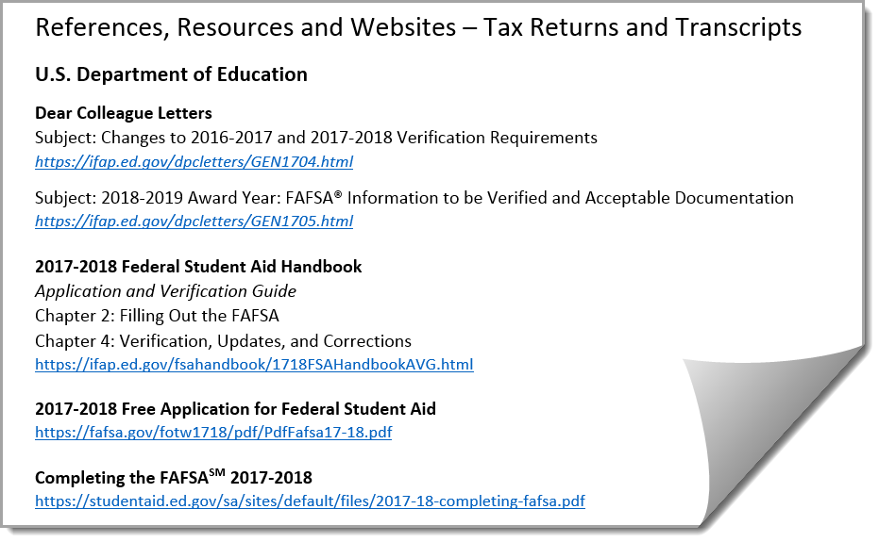
Resources
H-21
© 2017 Cheryl Hunt. All rights reserved.

Slide 40
Program Integrity Information
Questions and Answers
H-15
© 2017 Cheryl Hunt. All rights reserved.

Slide 41
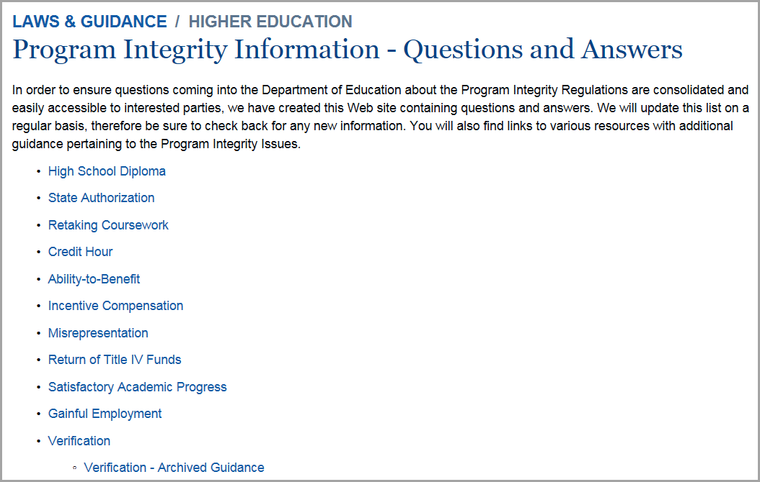
Program Integrity Information
Questions and Answers – VERIFICATION
H-16
© 2017 Cheryl Hunt. All rights reserved.

Slide 42
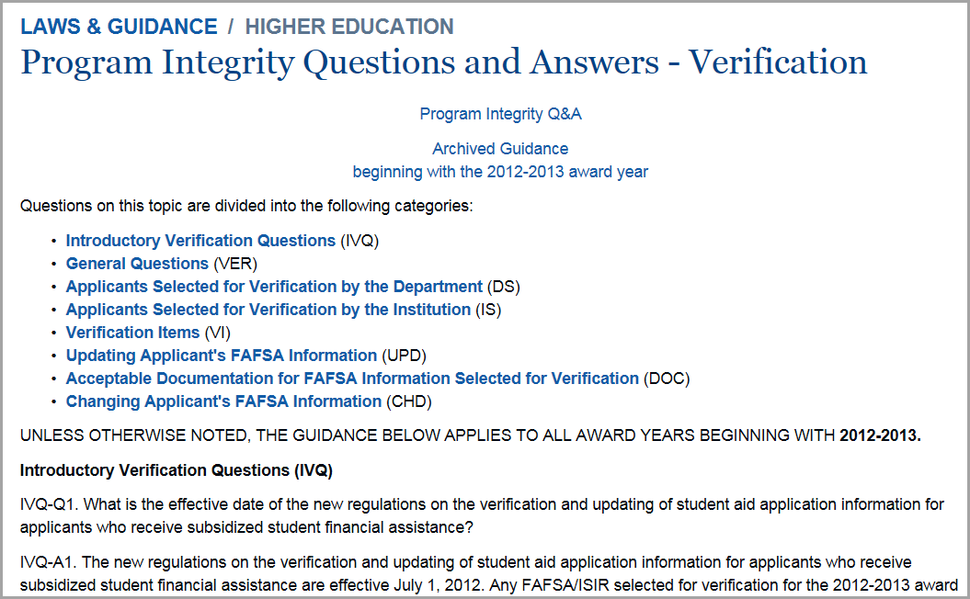
Program Integrity Information
Questions and Answers – VERIFICATION
H-16
© 2017 Cheryl Hunt. All rights reserved.

Slide 43
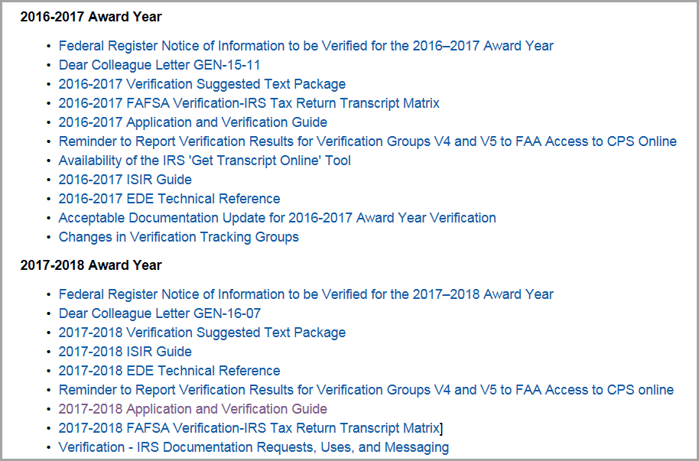
Program Integrity Information
Questions and Answers – VERIFICATION
H-17
© 2017 Cheryl Hunt. All rights reserved.

Slide 44
IFAP
Questions and Answers – VERIFICATION
H-17
© 2017 Cheryl Hunt. All rights reserved.

Slide 45
Tax Transcript Decoder
Cheryl Hunt
cheryl.hunt.trainer@gmail.com
© 2017 Cheryl Hunt. All rights reserved.
Notes:
I do have plans to update the Tax Transcript Decoder with 2016 income information to help with verifying applications for the 2018-2019 award year.
In order to do so, I need to get real copies of 2016 tax transcripts to work from. So keep me in mind if you get a 2016 tax transcript that you think might make a good example. Please mark out the PII, scan it and email it to me.
If all goes well, I should have the next version ready in time for this year’s CASFAA conference.

